Slide 1
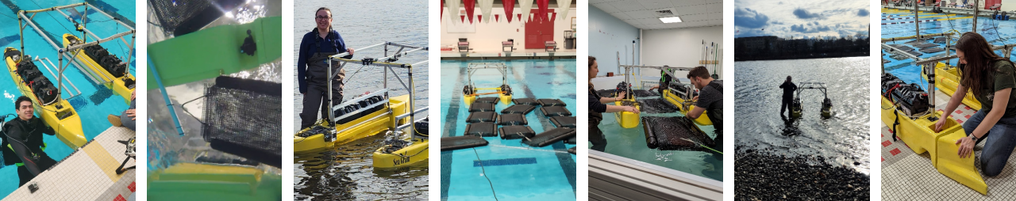

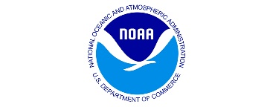
Oyster Farming by Autonomous
Surface Vehicles
MIT Sea Grant is a Federal-Institute partnership that promotes the conservation and sustainable development of coastal and marine resources through research, education, and outreach.
Daniel Klahn | Graduate Researcher, MIT Sea Grant
Fiona Gillespie | Graduate Researcher, MIT Sea Grant
Co-Authors: A. Dapoz, S. Monsalvo, A. Bennett, M. Triantafyllou
6 June 2023, Oyster Farming by Autonomous Surface Vehicles

Slide 2
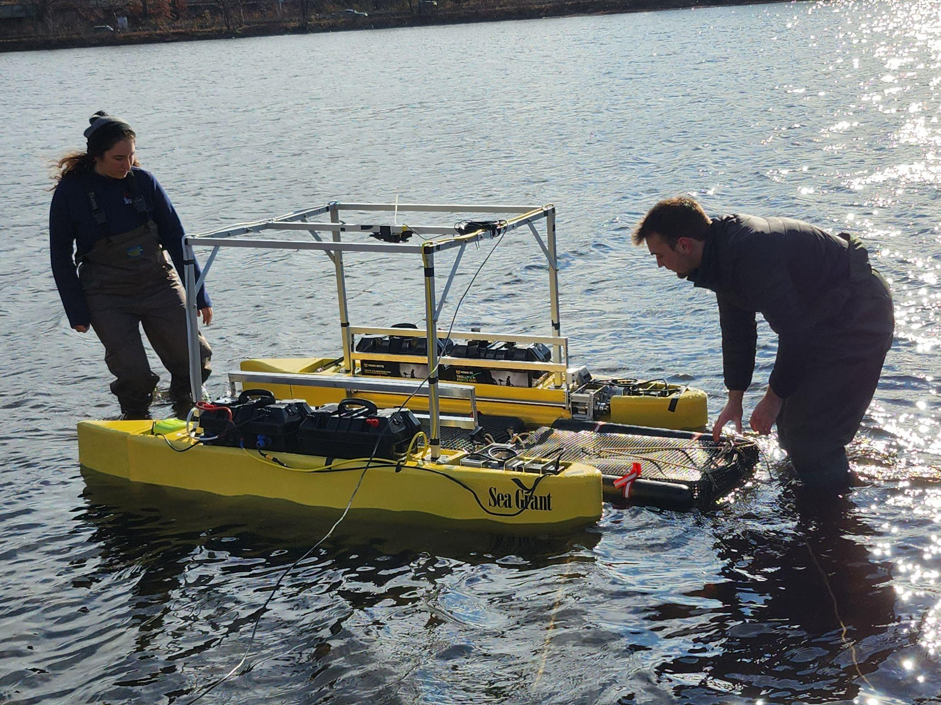
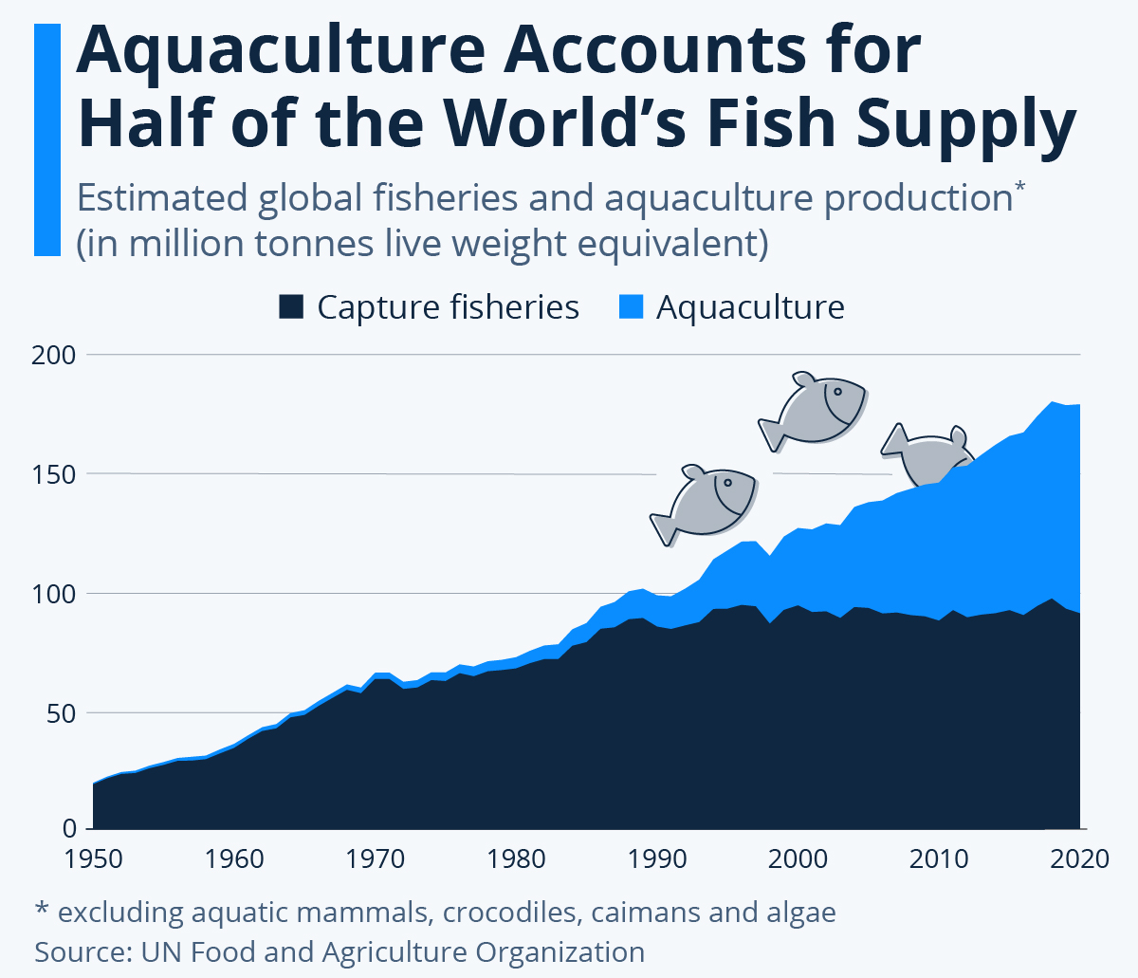
Aquaculture
Aquaculture is the rearing of aquatic animals and plants for food
Image Source: statista
6 June 2023, Oyster Farming by Autonomous Surface Vehicles

Slide 3
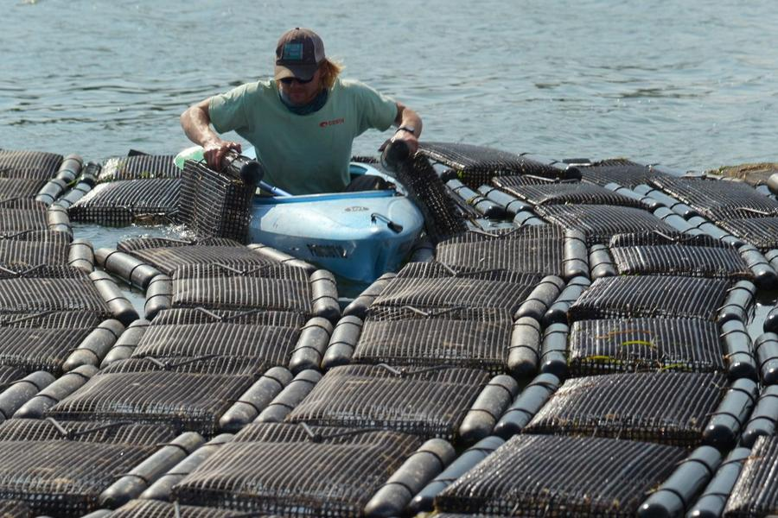
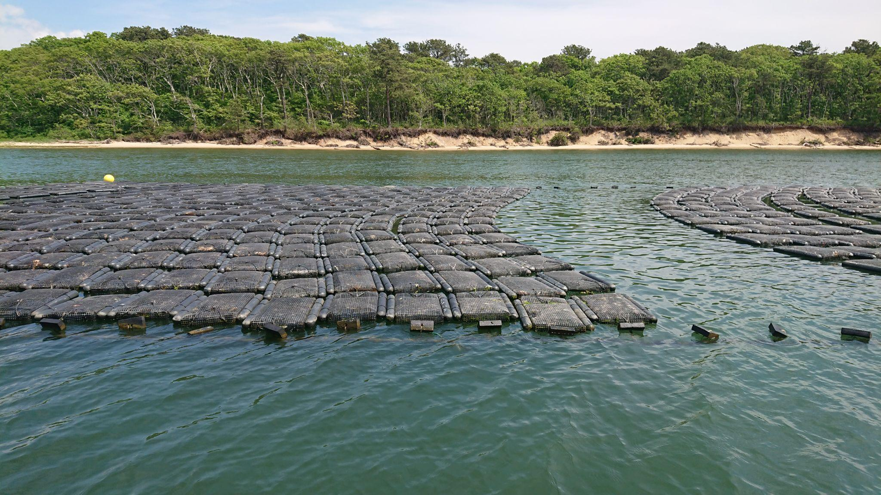
Flip Bag Oyster Farming
27 kg/60 lb
6 June 2023, Oyster Farming by Autonomous Surface Vehicles

Slide 4
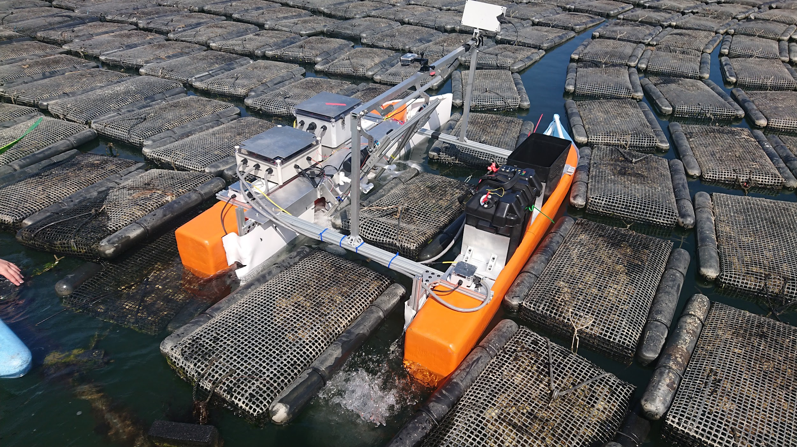
Previous Work: Oystermaran 1.0
2021 edition:
Validated proof-of-concept
Areas for improvement:
maneuverability
autonomy
6 June 2023, Oyster Farming by Autonomous Surface Vehicles

Slide 5
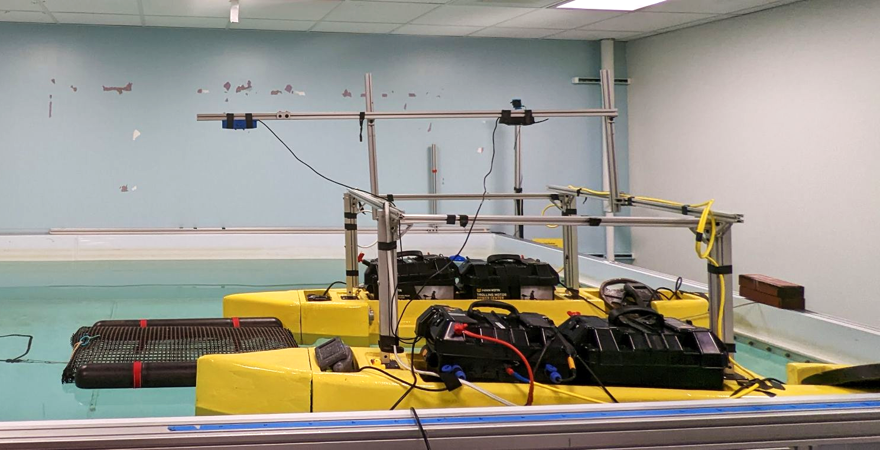
Current Solution: Oystermaran 2.0
2023 edition:
Custom motor controller
Basket locator (2.95m, 9’8’’ range)
Demo of integrated system
6 June 2023, Oyster Farming by Autonomous Surface Vehicles

Slide 6
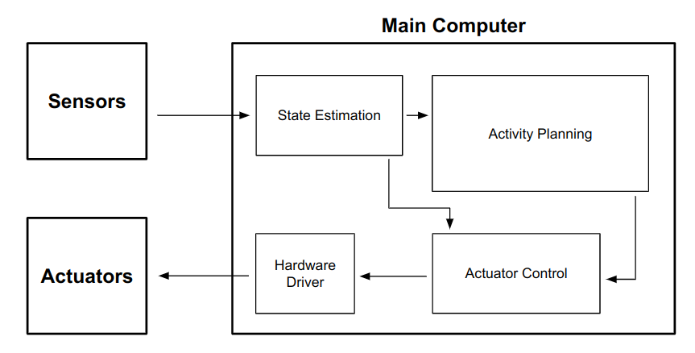
System Overview
6 June 2023, Oyster Farming by Autonomous Surface Vehicles
Notes:
Robotics System Diagram
Sensors: take in information about the environment
Actuators: allow the robot to interact with the environment
Main Computer: responsible for several simultaneous tasks
State Estimation: integrating the sensor information to estimate the state of itself and the environment (current position, presence/position of other objects, etc.)
Activity Planning: based on the current state of the world, decide what high level actions to take to accomplish the current goals
Actuator Control: translates high level actions into individual commands from each motor. This should also incorporate feedback from the sensors to achieve more robust control
Hardware Driver: Interfaces directly with the motors and other electronics
Our main computer uses ROS2 to manage each individual subsystem and their intercommunications
Our paper presents implementations of parts of the Actuator Control (control) and State Estimation (perception) subsystems for the Oystermaran
TODO: highlight ones we worked on

Slide 7
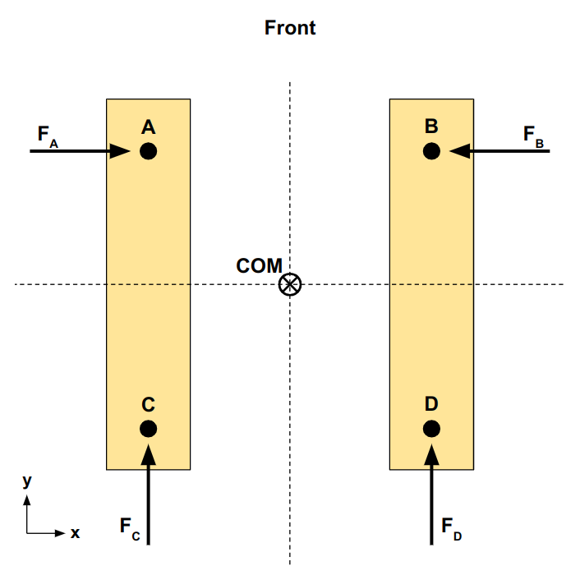
Controls - Hardware Setup
6 June 2023, Oyster Farming by Autonomous Surface Vehicles
Notes:
The Oystermaran has four T200 thrusters mounted as shown to enable movement through the oyster basket array.
The back thrusters provide forward/backward thrust
The front thrusters are mounted sideways and provide side to side thrust to help shove the baskets apart
Using Pixhawk 4 autopilot computer to control the thrusters, but its builtin configuration isn’t set up to handle thrusters in this configuration
We implemented our own dynamics-based motor controller that uses the equations of motion for the boat to determine the appropriate thruster commands

Slide 8
Controls - Motor Controller
Target Velocity
Thruster Commands
Dynamics-based motor controller:
Modeling equations of motion to determine
thruster commands
6 June 2023, Oyster Farming by Autonomous Surface Vehicles
Notes:
To keep things simple for the future autonomy systems, our desired control system would take in a target velocity (x, y, torque) and translate that into individual thruster commands that will cause the ASV to achieve that velocity
In order to accomplish this we implemented a dynamics-based

Slide 9
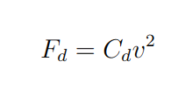
Controls - Forces
F_{C}
C
A
COM
F_{d}
Front
Drag Force
Drag
F_{D}
D
B
6 June 2023, Oyster Farming by Autonomous Surface Vehicles
Notes:
Our motor controller depends on modeling the physics of the boat as it moves through the water
In our physics model there are two forces acting on the boat: thruster forces and drag from the water
The drag force is proportional to the velocity squared: drag force depends on the speed of the boat

Slide 10
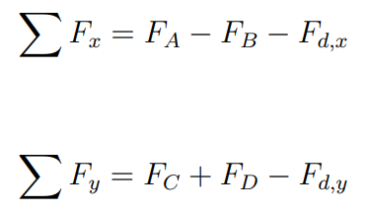
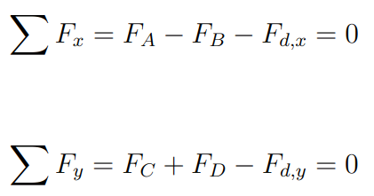
Controls - Dynamics
1.)
2.)
3.)
6 June 2023, Oyster Farming by Autonomous Surface Vehicles
Notes:
We can then write the equations of motion like this:
sum of forces in x, y, and sum of torques
When the boat reaches the target velocity, the acceleration will be zero and the thruster forces and drag forces will exactly cancel out.
We made the assumption that the boat accelerates fairly quickly so we set all these equations equal to zero, when the thruster forces and

Slide 11
Controls - Dynamics
1.)
2.)
3.)
Solve equations of motion for minimum force to achieve the target velocity
6 June 2023, Oyster Farming by Autonomous Surface Vehicles

Slide 12
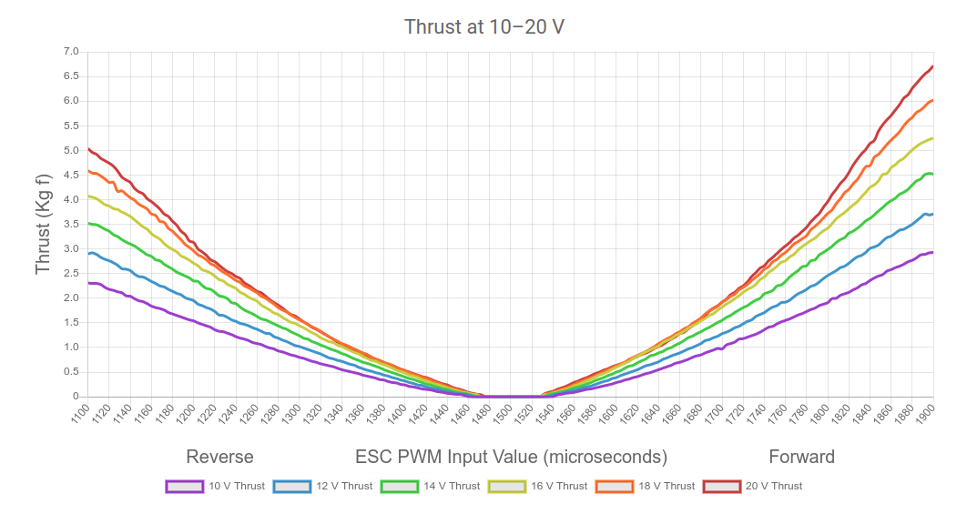
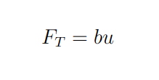
Controls - Solving for Thruster Commands
Thruster Force is Linear
Solving for target force also gives the desired thruster command
T200 thrust data from Blue Robotics
6 June 2023, Oyster Farming by Autonomous Surface Vehicles

Slide 13
System Overview
6 June 2023, Oyster Farming by Autonomous Surface Vehicles
Notes:
As I mentioned, the motor controller is part of the actuator control system, taking in high level commands and translating them into specific actions the thrusters should take
Our motor controller works pretty well! Give it a target velocity and it goes in the right direction. Improving performance a matter of tweaking parameters and adding sensors to provide feedback
The other subsystem we implemented is part of the state estimation system: responsible for processing sensor input to determine the state of the world around the robot
We created an oyster basket locating system that can determine the position of an oyster basket between the hulls
Robotics System Diagram
Sensors: take in information about the environment
Actuators: allow the robot to interact with the environment
Main Computer: responsible for several simultaneous tasks
State Estimation: integrating the sensor information to estimate the state of itself and the environment (current position, presence/position of other objects, etc.)
Activity Planning: based on the current state of the world, decide what high level actions to take to accomplish the current goals
Actuator Control: translates high level actions into individual commands from each motor. This should also incorporate feedback from the sensors to achieve more robust control
Hardware Driver: Interfaces directly with the motors and other electronics
Our main computer uses ROS2 to manage each individual subsystem and their intercommunications
Our paper presents implementations of parts of the Actuator Control (control) and State Estimation (perception) subsystems for the Oystermaran

Slide 14
Basket Locating
Position baskets correctly within the flipping mechanism
Keep track of position and progress through the basket array
6 June 2023, Oyster Farming by Autonomous Surface Vehicles
Notes:
On the hardware side, the Oystermaran has two overhead cameras that look down between the hulls. We then created a software system that processes the camera images to determine the position of the oyster baskets
It’s important for the boat to know where the oyster baskets are so that it can ensure that the baskets are positioned correctly within the flipping mechanism
We also plan on using this information to augment GPS to help keep track of the boats progress through the array: how many baskets it has passed
The ASV has two overhead cameras that look down between the hulls
We developed a system to process these images to determine the exact location oyster baskets between the hulls (TODO: pic for this)
talk about why we need to determine basket position:
Position baskets in flipping mechanism
Keep track of own location

Slide 15
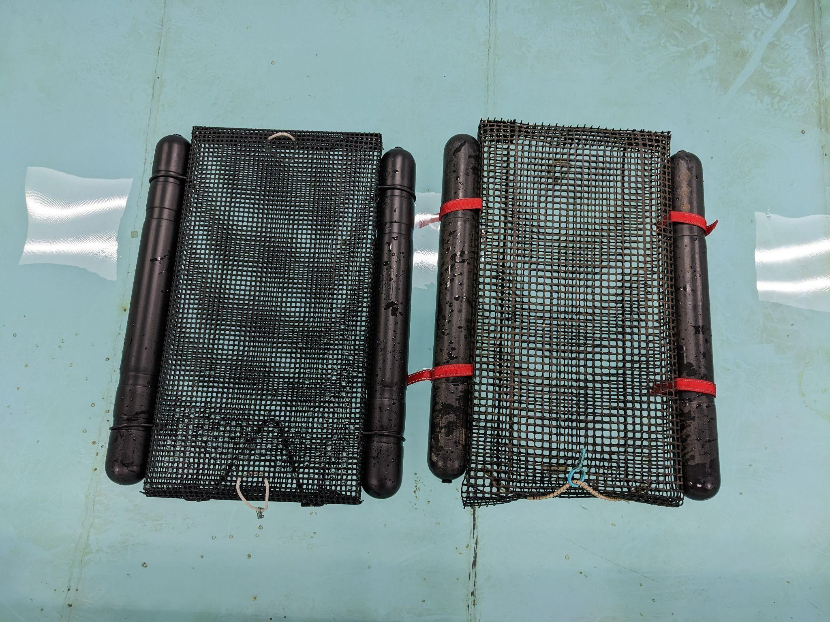
Basket Locating
6 June 2023, Oyster Farming by Autonomous Surface Vehicles
Notes:
So to give you a better idea of what we’re working with, here are two oyster baskets like the ones used at Ward Aquafarms

Slide 16
Basket Locating
Bag
Floats
6 June 2023, Oyster Farming by Autonomous Surface Vehicles
Notes:
The baskets are made of a rigid plastic bag which holds the oysters, and two black plastic floats which keep the basket at the surface of the water

Slide 17
Basket Locating
Red straps provide an easily detectable marker to determine the basket’s position
6 June 2023, Oyster Farming by Autonomous Surface Vehicles
Notes:
Left: black rubber bands are current
Right: Added red straps as a marker to determine position
Red straps should stick out against biofouling in a wide range of lighting conditions
You can see that on the left, the floats are attached to the bag via black rubber bands. This is how the baskets are currently constructed at Ward Aquafarms
On the right, the black rubber bands are replaced by bright red straps that hold the floats in place.
We added these straps as a minimal modification to the baskets that provides a robust marker to determine the basket’s position
The large red straps should boldly stand out in a wide range of lighting conditions and against any biofouling that accumulates

Slide 18
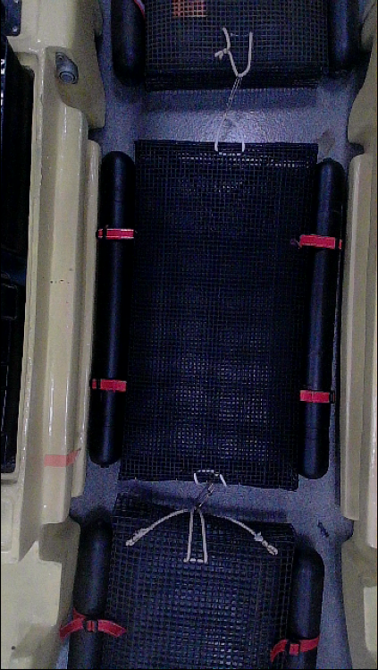
Basket Locating Steps
Overhead camera image
6 June 2023, Oyster Farming by Autonomous Surface Vehicles
Notes:
Our approach has several steps that we’ll go into in more detail, but at a high level they are:
Steps:
Getting an image from the cameras
Picking out the red regions from the image -> generate point cloud
Always the possibility of spurious red regions, so determining which set of points correspond to the basket
Determine the basket center
Our approach isolates the red regions using traditional image processing techniques which are fast and robust
We then determining which of the resulting regions most likely correspond to the straps on the oyster bag.
We do this using a point cloud correspondence algorithm that we developed which finds sets of points that closely match the expected rectangle of strap points
Add more roadmap stuff to these slides

Slide 19
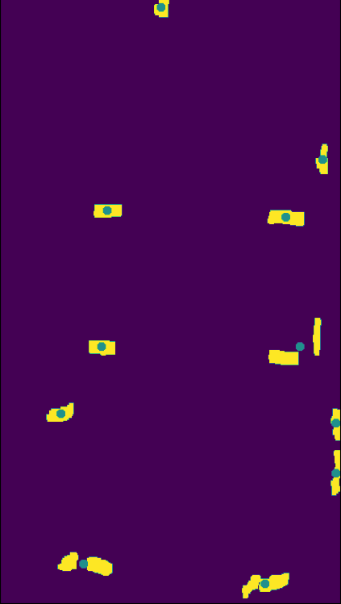
Basket Locating Steps
Overhead camera image
Isolate red straps
6 June 2023, Oyster Farming by Autonomous Surface Vehicles
Notes:
Our approach has several steps that we’ll go into in more detail, but at a high level they are:
Steps:
Getting an image from the cameras
Picking out the red regions from the image -> generate point cloud
Always the possibility of spurious red regions, so determining which set of points correspond to the basket
Determine the basket center
Our approach isolates the red regions using traditional image processing techniques which are fast and robust
We then determining which of the resulting regions most likely correspond to the straps on the oyster bag.
We do this using a point cloud correspondence algorithm that we developed which finds sets of points that closely match the expected rectangle of strap points
Add more roadmap stuff to these slides

Slide 20
Basket Locating Steps
Overhead camera image
Isolate red straps
Find straps corresponding to the basket
6 June 2023, Oyster Farming by Autonomous Surface Vehicles
Notes:
Our approach has several steps that we’ll go into in more detail, but at a high level they are:
Steps:
Getting an image from the cameras
Picking out the red regions from the image -> generate point cloud
Always the possibility of spurious red regions, so determining which set of points correspond to the basket
Determine the basket center
Our approach isolates the red regions using traditional image processing techniques which are fast and robust
We then determining which of the resulting regions most likely correspond to the straps on the oyster bag.
We do this using a point cloud correspondence algorithm that we developed which finds sets of points that closely match the expected rectangle of strap points
Add more roadmap stuff to these slides

Slide 21
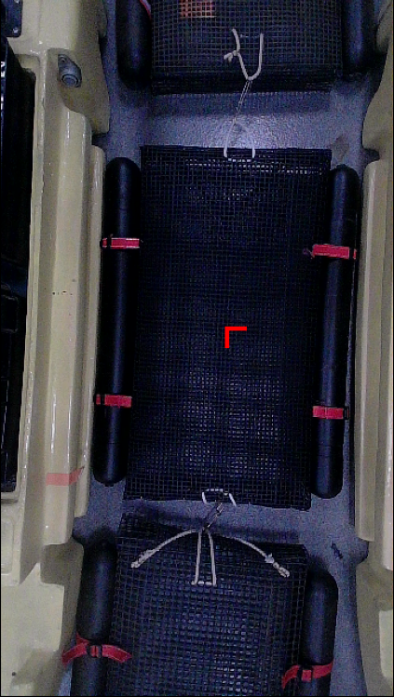
Basket Locating Steps
Overhead camera image
Isolate red straps
Find straps corresponding to the basket
Calculate basket center
6 June 2023, Oyster Farming by Autonomous Surface Vehicles
Notes:
Our approach has several steps that we’ll go into in more detail, but at a high level they are:
Steps:
Getting an image from the cameras
Picking out the red regions from the image -> generate point cloud
Always the possibility of spurious red regions, so determining which set of points correspond to the basket
Determine the basket center
Our approach isolates the red regions using traditional image processing techniques which are fast and robust
We then determining which of the resulting regions most likely correspond to the straps on the oyster bag.
We do this using a point cloud correspondence algorithm that we developed which finds sets of points that closely match the expected rectangle of strap points
Add more roadmap stuff to these slides

Slide 22
Isolating the Straps
Raw camera image
6 June 2023, Oyster Farming by Autonomous Surface Vehicles
Notes:
The first step is to isolate the red straps in the image
We do this by converting the image from the normal red, green, blue colorspace to the hue, saturation, value color space and then selecting the pixels whose hue values fall within a certain range
The hue channel encodes the color information. The first image shows the raw camera image and this image (IMAGE 2) shows just the hue channel. You can see that the red areas have high pixel values and are easy to distinguish
If we take all the pixels that have a hue above a certain threshold, we get something like this (IMAGE 3), which is pretty good, but it has a bunch of random pixels from other things in the environment.
We can significantly clean this up by performing a small object removal operation that removes most of these spurious pixels

Slide 23
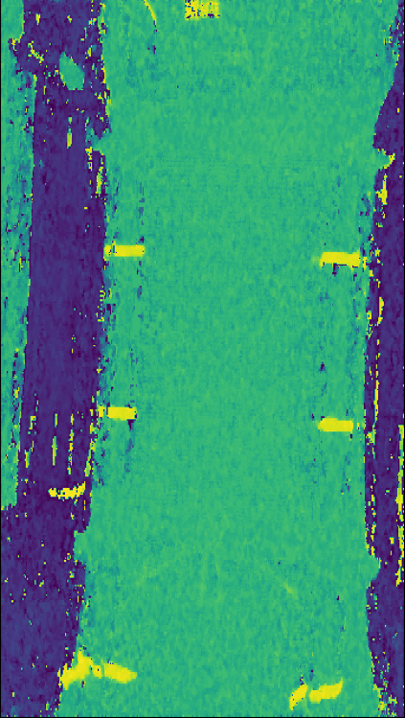
Isolating the Straps
Raw camera image
Hue channel
6 June 2023, Oyster Farming by Autonomous Surface Vehicles
Notes:
The first step is to isolate the red straps in the image
We do this by converting the image from the normal red, green, blue colorspace to the hue, saturation, value color space and then selecting the pixels whose hue values fall within a certain range
The hue channel encodes the color information. The first image shows the raw camera image and this image (IMAGE 2) shows just the hue channel. You can see that the red areas have high pixel values and are easy to distinguish
If we take all the pixels that have a hue above a certain threshold, we get something like this (IMAGE 3), which is pretty good, but it has a bunch of random pixels from other things in the environment.
We can significantly clean this up by performing a small object removal operation that removes most of these spurious pixels

Slide 24
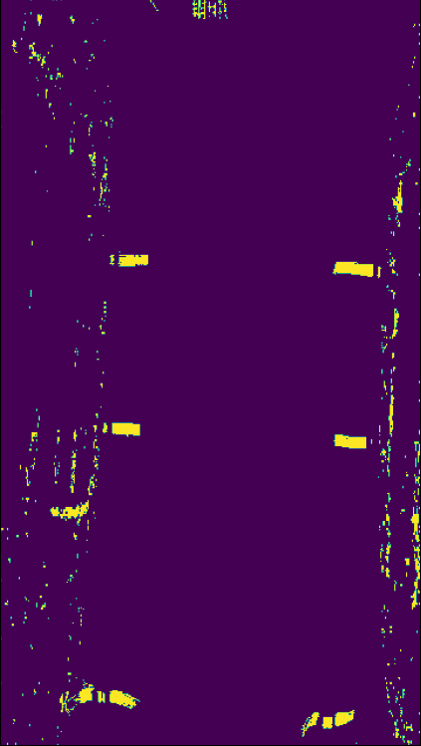
Isolating the Straps
Raw camera image
Hue channel
HSV thresholding
6 June 2023, Oyster Farming by Autonomous Surface Vehicles
Notes:
The first step is to isolate the red straps in the image
We do this by converting the image from the normal red, green, blue colorspace to the hue, saturation, value color space and then selecting the pixels whose hue values fall within a certain range
The hue channel encodes the color information. The first image shows the raw camera image and this image (IMAGE 2) shows just the hue channel. You can see that the red areas have high pixel values and are easy to distinguish
If we take all the pixels that have a hue above a certain threshold, we get something like this (IMAGE 3), which is pretty good, but it has a bunch of random pixels from other things in the environment.
We can significantly clean this up by performing a small object removal operation that removes most of these spurious pixels

Slide 25
Isolating the Straps
Raw camera image
Hue channel
HSV thresholding
Cleaned up mask
6 June 2023, Oyster Farming by Autonomous Surface Vehicles
Notes:
The first step is to isolate the red straps in the image
We do this by converting the image from the normal red, green, blue colorspace to the hue, saturation, value color space and then selecting the pixels whose hue values fall within a certain range
The hue channel encodes the color information. The first image shows the raw camera image and this image (IMAGE 2) shows just the hue channel. You can see that the red areas have high pixel values and are easy to distinguish
If we take all the pixels that have a hue above a certain threshold, we get something like this (IMAGE 3), which is pretty good, but it has a bunch of random pixels from other things in the environment.
We can significantly clean this up by performing a small object removal operation that removes most of these spurious pixels

Slide 26
Which points correspond to an oyster basket?
Raw camera image
Hue thresholding
6 June 2023, Oyster Farming by Autonomous Surface Vehicles
Notes:
So this leaves us with a pretty good map of where the large red regions are in our image which are likely to correspond with the red straps on the baskets
Guesses as to where straps might be
We can then find the center of each red region and create a set of points that are our candidates for where the basket straps might be.
The question then becomes: which of these points actually correspond to the oyster basket?

Slide 27
Finding Point Correspondences
Known Strap Pattern
6 June 2023, Oyster Farming by Autonomous Surface Vehicles
Notes:
We know that the basket straps should be in this rectangular pattern, so we need to find the points from the hsv filtering step that closely match this target shape
Looked into existing algorithms, this is similar to another problem in robotics called point cloud registration which is ______
This problem is different (called finding point correspondences: explain ____) and we couldn’t find an existing algorithm that fit our purpose
Trying to find a set of points in this set that match the known pattern

Slide 28
Finding Point Correspondences
1.) Generate Correspondence Proposals
2.) Evaluate Each Proposal
3.) Pick the Best One
6 June 2023, Oyster Farming by Autonomous Surface Vehicles
Notes:
Steps:

Slide 29
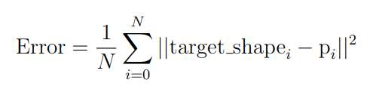
Evaluating Correspondence Proposals
Evaluate based on the average distance between the target shape points and the proposal points
Mean Squared Error
distance
6 June 2023, Oyster Farming by Autonomous Surface Vehicles
Notes:
Evaluate based on mean squared error
Connect shape

Slide 30
Evaluating Correspondence Proposals
Evaluate based on the average distance between the target shape points and the proposal points
Mean Squared Error
distance
6 June 2023, Oyster Farming by Autonomous Surface Vehicles
Notes:
Evaluate based on mean squared error
Connect shape

Slide 31
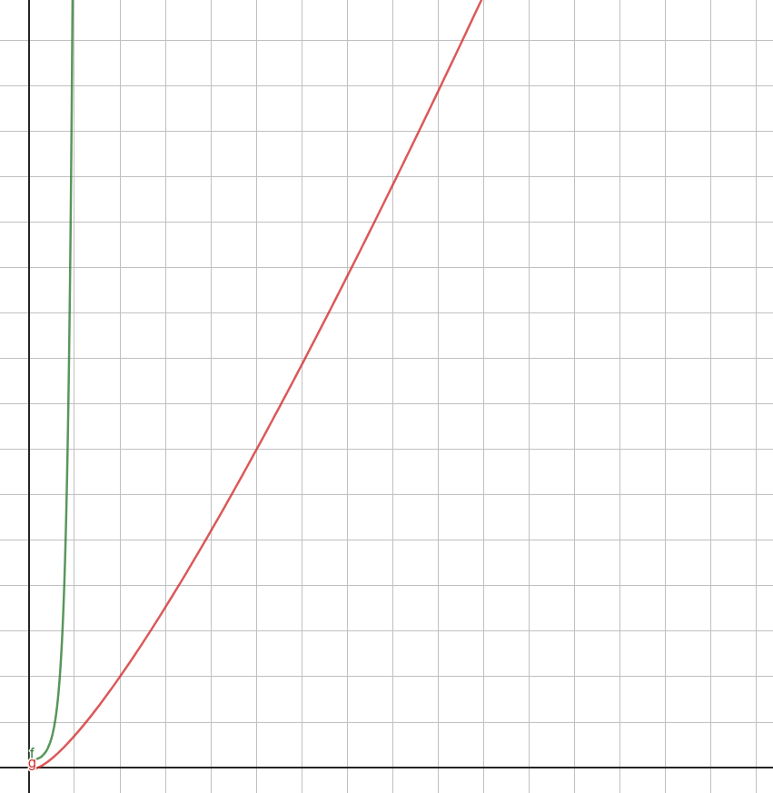
Generating Proposals
brute force
Locating baskets quickly:
Minimizing proposals
# proposals generated
our algorithm
Brute Force: Exponential
Our Algorithm: Log Linear
# possible strap points
6 June 2023, Oyster Farming by Autonomous Surface Vehicles
Notes:
The clever part of this algorithm is making it fast and generating good proposals is the most important factor
Each proposal takes time, would like to minimize number of proposals
# proposals is related to the number of possible straps points which can sometimes be large if there’s a lot of noise/stuff
One easy way to generate proposals would be to brute force and try every combination of 4 points
This leads to lots

Slide 32
Generating Proposals
Guess that a point corresponds to a strap
Based on that guess, where should the other straps be?
Find the point that is nearest to the expected strap location
Greatly reduces the number of proposals
Store points in a KDTree: fast nearest neighbors search
6 June 2023, Oyster Farming by Autonomous Surface Vehicles
Notes:
Instead of trying all combinations of points, we can be a bit smarter

Slide 33
Basket Locating Steps
Overhead camera image
Isolate red straps
Find straps corresponding to the basket
Calculate basket center
6 June 2023, Oyster Farming by Autonomous Surface Vehicles
Notes:
Our implementation allows it to do this
But how well does it work?

Slide 34
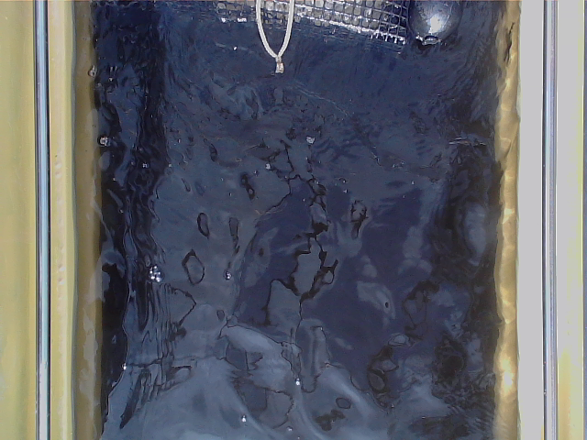
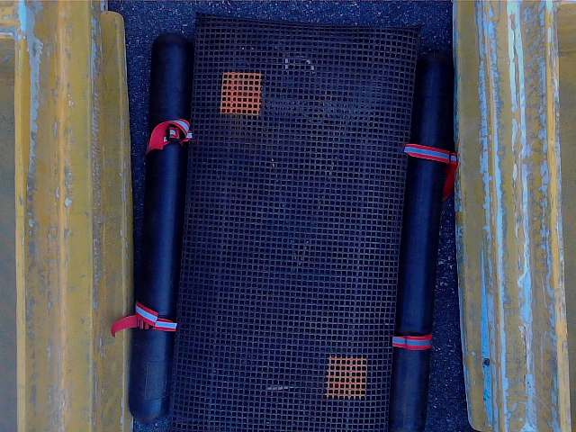
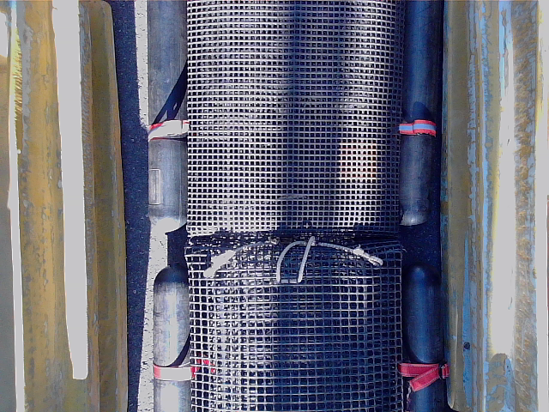
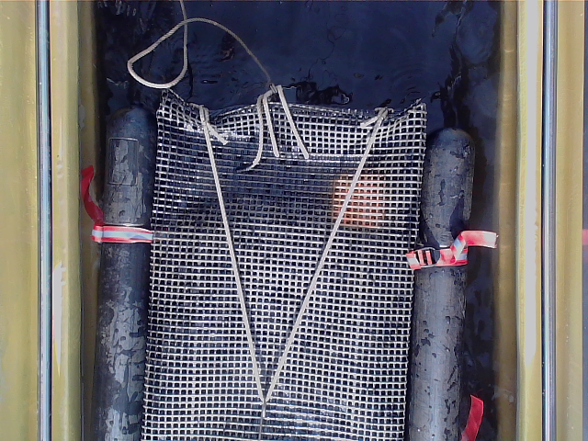
Basket Locating Results
Tested algorithm on 189 images across various lighting conditions and basket positions
6 June 2023, Oyster Farming by Autonomous Surface Vehicles
Notes:
It’s important that the Oystermaran can function outside in various lighting conditions, so we tested our algorithm on a set of 189 test images across various lighting conditions and basket positions
The test set contains images taken in full shade, direct sunlight, and uneven shade
We also included images in which the basket is fully in frame, partially in frame, and when there are multiple baskets in frame (particularly hard because the straps form a similar rectangle)

Slide 35
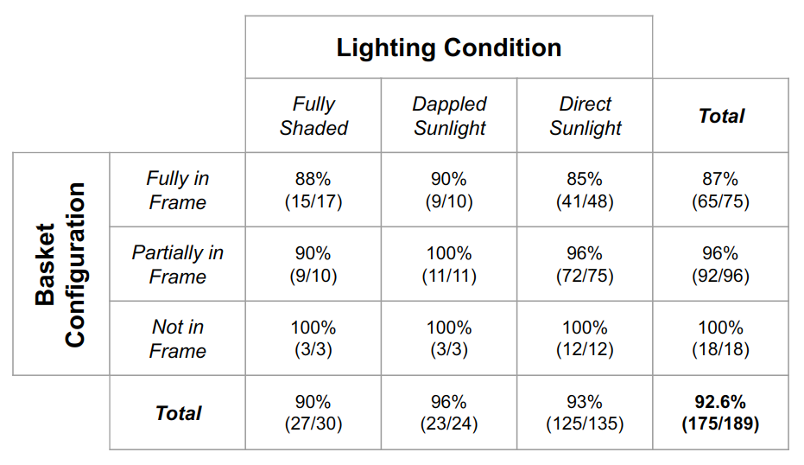
Basket Locator Results
92.6% success!
49ms on Raspberry Pi 4
6 June 2023, Oyster Farming by Autonomous Surface Vehicles
Notes:
This table breaks down the algorithms performance across

Slide 36
System Overview
6 June 2023, Oyster Farming by Autonomous Surface Vehicles
Notes:
So over the past few months we’ve worked on developing these two subsystems, so I’ll pass it back to Fiona to talk about how we tested these systems working together
Robotics System Diagram
Sensors: take in information about the environment
Actuators: allow the robot to interact with the environment
Main Computer: responsible for several simultaneous tasks
State Estimation: integrating the sensor information to estimate the state of itself and the environment (current position, presence/position of other objects, etc.)
Activity Planning: based on the current state of the world, decide what high level actions to take to accomplish the current goals
Actuator Control: translates high level actions into individual commands from each motor. This should also incorporate feedback from the sensors to achieve more robust control
Hardware Driver: Interfaces directly with the motors and other electronics
Our main computer uses ROS2 to manage each individual subsystem and their intercommunications
Our paper presents implementations of parts of the Actuator Control (control) and State Estimation (perception) subsystems for the Oystermaran
TODO: highlight ones we worked on

Slide 37
System Integration Goals
Basket
Oystermaran
6 June 2023, Oyster Farming by Autonomous Surface Vehicles
Notes:
Our motor controller depends on modeling the physics of the boat as it moves through the water
In our physics model there are two forces acting on the boat: thruster forces and drag from the water
thruster commands end up being proportional to target velocity

Slide 38
System Integration Goals: Locate Basket
6 June 2023, Oyster Farming by Autonomous Surface Vehicles
Notes:
Our motor controller depends on modeling the physics of the boat as it moves through the water
In our physics model there are two forces acting on the boat: thruster forces and drag from the water
thruster commands end up being proportional to target velocity

Slide 39
System Integration Goals: Calculate Response
6 June 2023, Oyster Farming by Autonomous Surface Vehicles
Notes:
Our motor controller depends on modeling the physics of the boat as it moves through the water
In our physics model there are two forces acting on the boat: thruster forces and drag from the water
thruster commands end up being proportional to target velocity

Slide 40
System Integration Goals: Center Over Basket
6 June 2023, Oyster Farming by Autonomous Surface Vehicles
Notes:
Our motor controller depends on modeling the physics of the boat as it moves through the water
In our physics model there are two forces acting on the boat: thruster forces and drag from the water
thruster commands end up being proportional to target velocity

Slide 41
System Integration Goals: Center Over Basket
6 June 2023, Oyster Farming by Autonomous Surface Vehicles
Notes:
Our motor controller depends on modeling the physics of the boat as it moves through the water
In our physics model there are two forces acting on the boat: thruster forces and drag from the water
thruster commands end up being proportional to target velocity

Slide 42
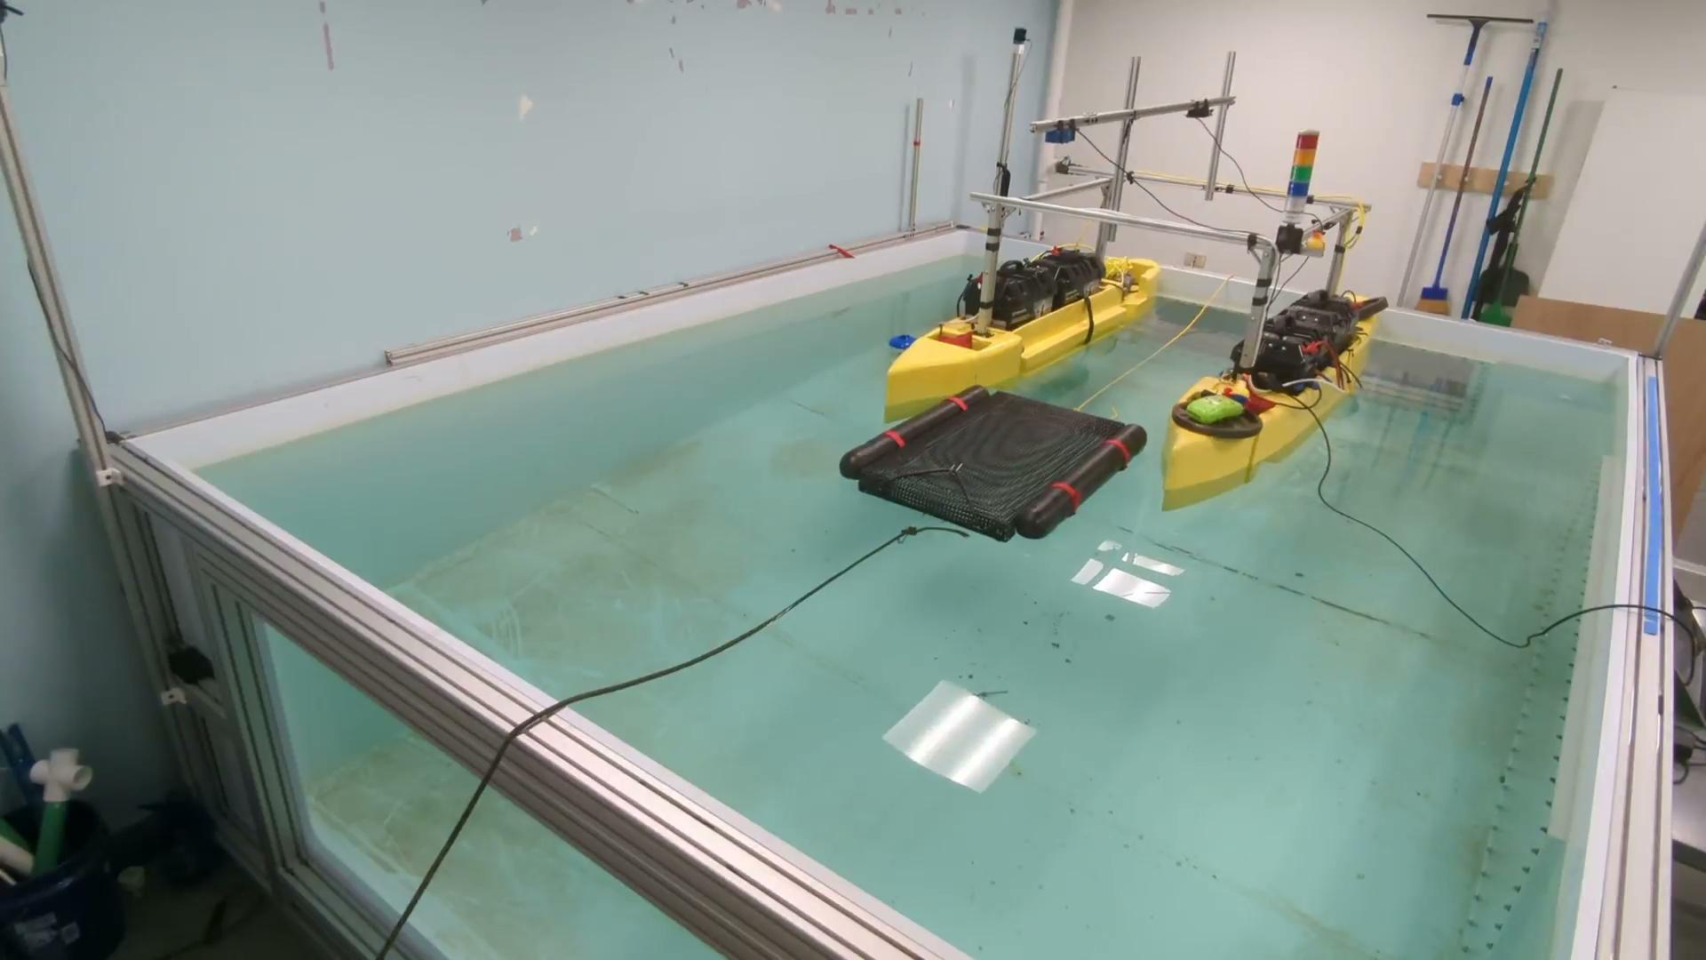
System Integration Demo
6 June 2023, Oyster Farming by Autonomous Surface Vehicles
Notes:
add another system integration slide to reorient the viewer
add more context for what will happen in the test (copy our graphics of hulls)

Slide 43
System Integration Demo
6 June 2023, Oyster Farming by Autonomous Surface Vehicles
Notes:
add another system integration slide to reorient the viewer
add more context for what will happen in the test (copy our graphics of hulls)

Slide 44
Next Steps
Track progress through array
Move between rows
Maneuver resiliently through crowded array
Scale up simulation
6 June 2023, Oyster Farming by Autonomous Surface Vehicles

Slide 45
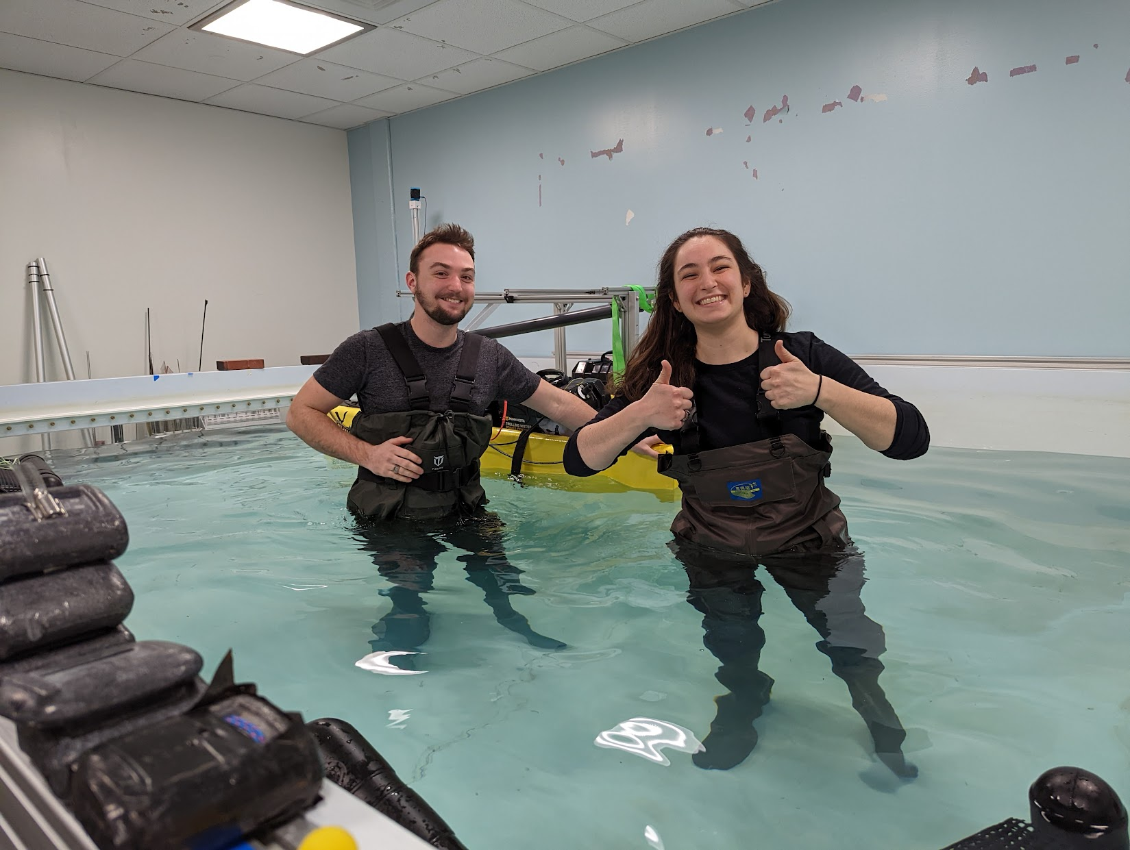
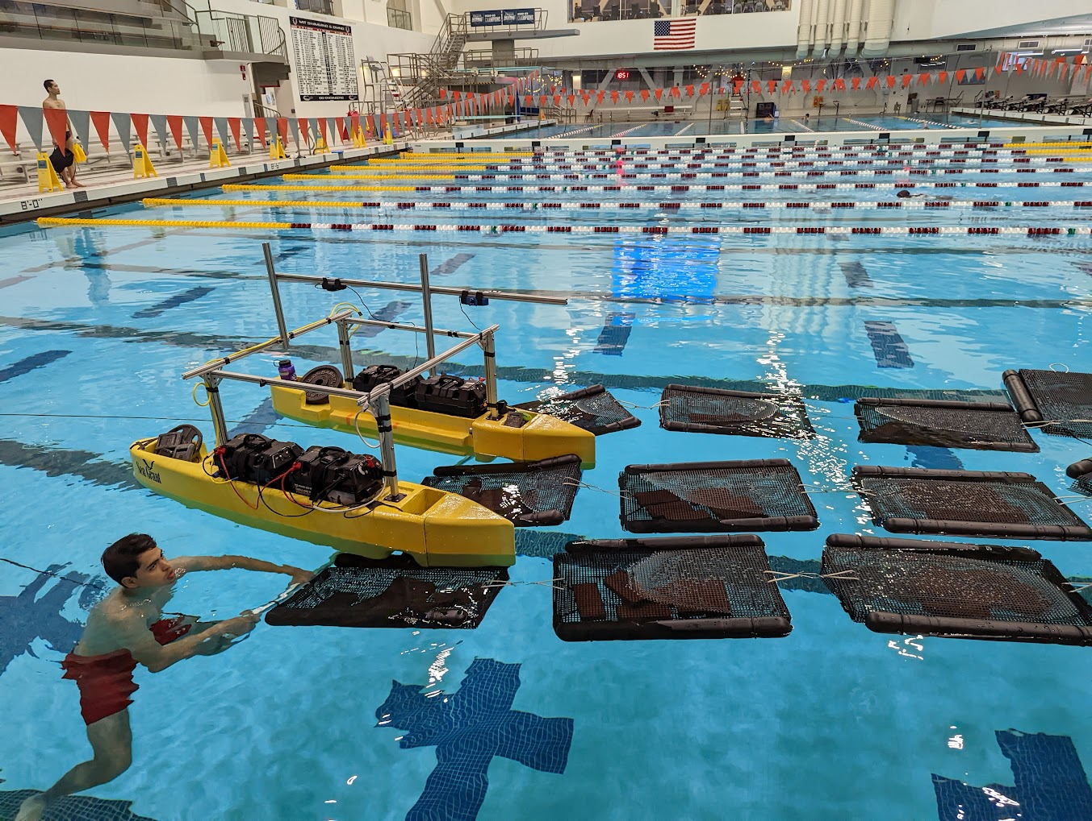
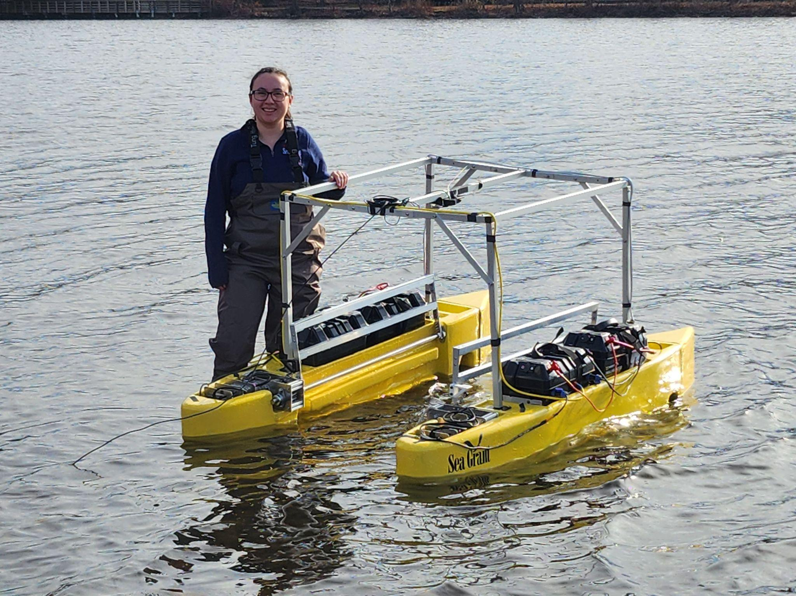
seagrant.mit.edu/oystermaran | oystermaran@mit.edu | @MITSeaGrant
6 June 2023, Oyster Farming by Autonomous Surface Vehicles

Slide 46
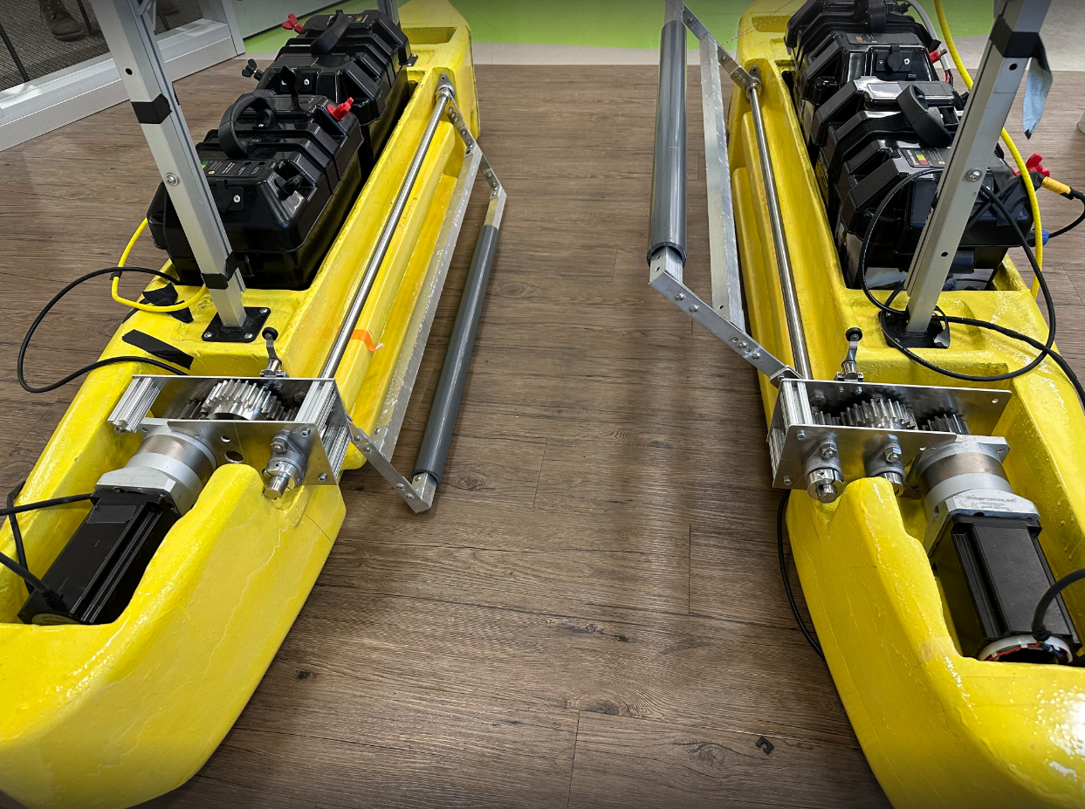
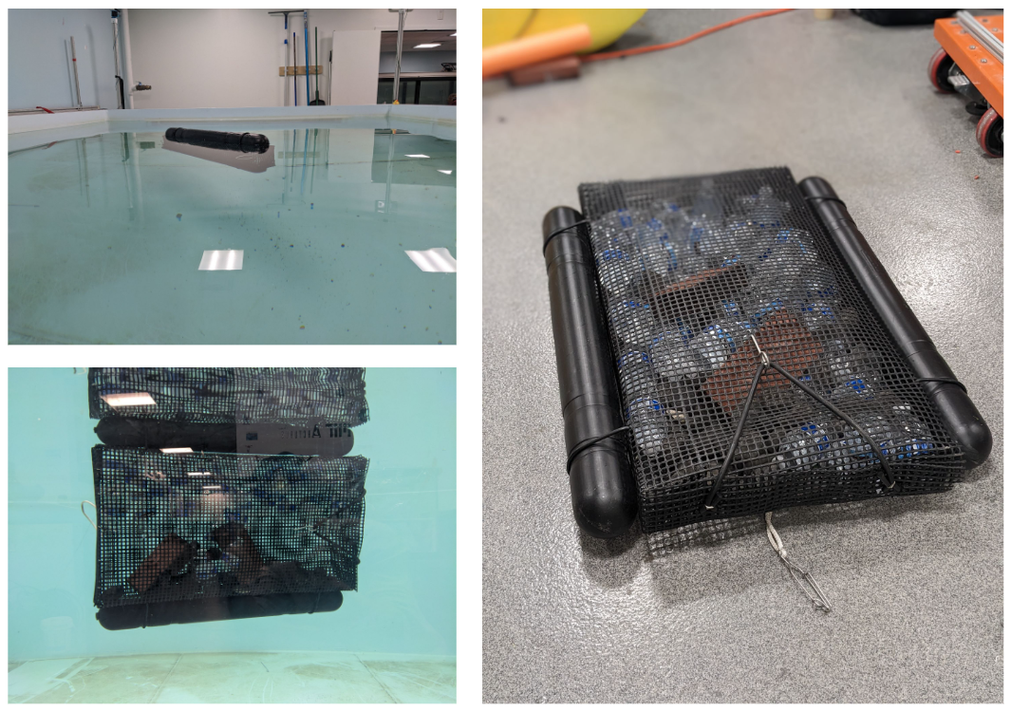
Flipping Mechanism
6 June 2023, Oyster Farming by Autonomous Surface Vehicles

Slide 47
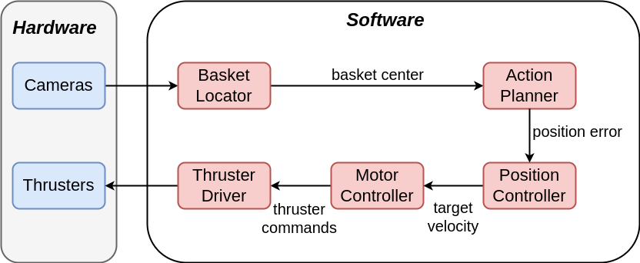
System Integration
6 June 2023, Oyster Farming by Autonomous Surface Vehicles

Slide 48
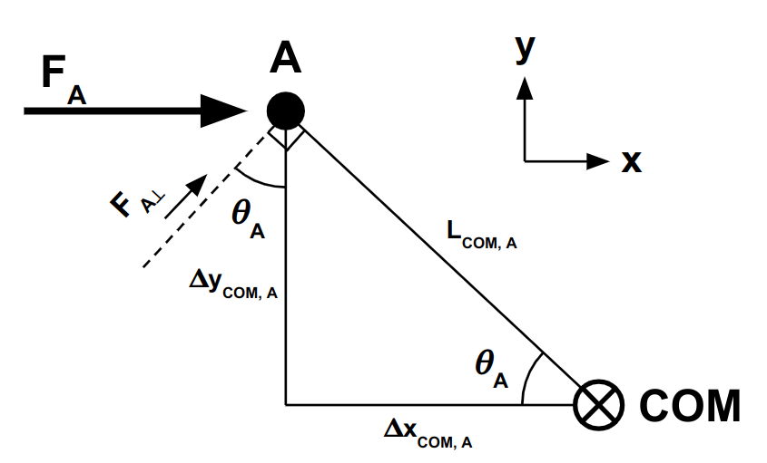
Controls - Dynamics
6 June 2023, Oyster Farming by Autonomous Surface Vehicles

